Slide 1
Artificial Intelligence Chapter 3: Heuristic search techniques

Slide 2
Index
Heuristic (Informed) searching techniques
Heuristic function
Best (Greedy) first search
A* search
Problem reduction
AO* search
Generate and Test algorithm
Local search
Hill climbing, problems in hill climbing, types of hill climbing
Constraint satisfaction problem
Constraint satisfaction
Crypt arithmetic problem
Mean End Analysis
Stochastic search
NOTE: PPT contains some topics from 2nd unit

Slide 3
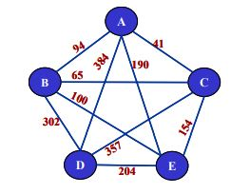
Informed search(heuristic)
Informed search is a problem specific search. These algorithms use domain knowledge
The search strategy depends on the information available for a specific search problem.
Informed search strategies can find a solution more efficiently than an uninformed search strategy. Informed search is also called a Heuristic search
Heuristic function is used to find the path that can lead to the goal state. This function can judge the available path by ranking them.
There is a high probability that the path selected by heuristic function will lead us to goal but not guaranteed
Informed search can solve much complex problem which could not be solved in another way. An example of informed search algorithms is a travelling salesman problem.
It can be divided into these types:
Best First (Greedy) Search
A* Search
AO* search
Local search

Slide 4
Heuristic function
Heuristic is a function which is used in Informed Search, and it finds the most promising path.
It takes the current state of the agent as its input and produces the estimation of how close agent is from the goal.
The heuristic method, however, might not always give the best solution, but it guaranteed to find a good solution in reasonable time.
Heuristic function estimates how close a state is to the goal.
Heuristic function is denoted by h(n) & it calculates the cost of an optimal path between the pair of states.
h(n) = cost of cheapest path from node n to goal node
The value of the heuristic function is always positive.

Slide 5
Heuristic function
Working/algorithm:
It expands nodes based on their heuristic value h(n). It maintains two lists, OPEN and CLOSED list.
In the CLOSED list, it places those nodes which have already expanded and
In the OPEN list, it places nodes which have yet not been expanded
On each iteration, each node n with the lowest heuristic value is expanded and generates all its successors and n is placed to the closed list.
The algorithm continues unit a goal state is found.
Admissibility of the heuristic function is given as:
h(n) <= h*(n)
Here h(n) is heuristic cost, and h*(n) is the estimated cost. Hence heuristic cost should be less than or equal to the estimated cost.

Slide 6
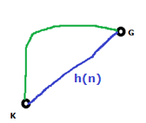

Examples: Heuristic function
Want path from Kolkata to Guwahati : Heuristic for Guwahati may be straight line distance between Kolkata and Guwahati
So this distance, the straight line distance between K and G is an underestimate of the actual distance of the path from K to G.
h(Kolkata)= Euclideandistance(Kolkata, Guwahati)

Slide 7
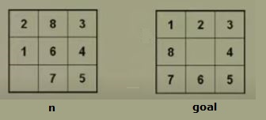
Examples: Heuristic function
8-puzzel problem : One heuristic for 8-puzzel is the number of tiles out of place.
So the heuristic at node n is equal to 5 because five tiles are not in their correct location. and we must make at least five moves to move them to their correct location.
So h(n)=5 is an under estimate of the actual number of steps requires to move to the goal state.

Slide 8
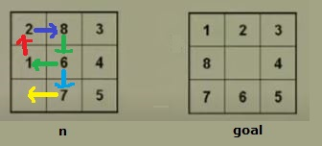
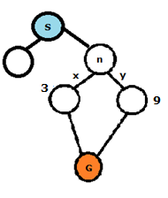
Examples: Heuristic function
8-puzzel problem : Another heuristic for 8-puzzel is Manhattan distance heuristics.
So h(n) in this case is,
h(n) = 1+2+1+1+1 = 6
So this is under estimate of the actual number of moves required to move from this state to this state.

Slide 9
Best First Search(Greedy): Informed
Best first search is based on tree search or Graph Search problem. The nodes are expanded and explored one by one. An evaluation function f(n) is used to decide which node is to be expanded next.
Best first search algorithm always selects the path which appears best at that moment.
By convention the node which has the lowest value of evaluation is selected for expansion, since evaluation value represents the distance from the goal state.
Best first search strategy enables us to switch between paths. This path switching enables it to use feature of both tracking when previous node promises a better solution than current one.
Best first search is the generalization Breadth first search where open list is maintained as a priority queue. And cost function f(n) is used which denotes the priority of a node.
In this approach node evaluation is entirely dependent on heuristic function i.e.
f(n)=h(n)
Where, h(n)= estimated cost from node n to the goal.

Slide 10
Best First Search(Greedy): Informed
Algorithm:
OPEN list is maintained as a priority queue containing the initial state.
loop
If OPEN is empty return failure
Remove the first element with highest priority from open list & put it into close list
If node is goal we return the path from initial state to the node
else we generate all successors of node.
Put the newly generated nodes into open list according to their f(n) values.
End loop

Slide 11
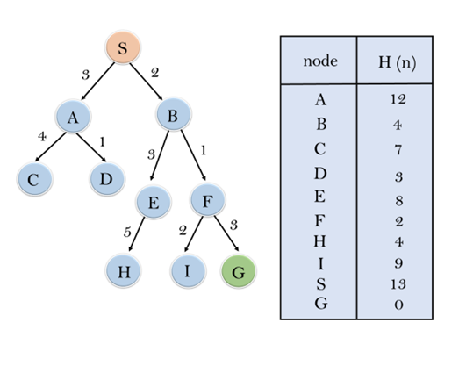
Best First Search(Greedy): Informed
We use the straight line heuristic. h(n) is taken to be the straight line distance(Euclidean distance) from n to the goal position
Expand the nodes of S and put in the CLOSED list
Initialization: Open [B, A], Closed [S]
Iteration 1: Open [A], Closed [S, B]
Iteration 2: Open [F, E, A], Closed [S, B] : Open [E, A], Closed [S, B, F]
Iteration 3: Open [G, I, E, A], Closed [S, B, F] : Open [I, E, A], Closed [S, B, F, G]
Hence the final solution path will be:
S----> B----->F----> G

Slide 12
Best First Search(Greedy): Informed
However this algorithm is not optimal & not complete(incomplete). So greedy search not always gives us optimum solution.
The worst case time & space complexity of Greedy best first search is O(b^{m}). Where, m is the maximum depth of the search space

Slide 13
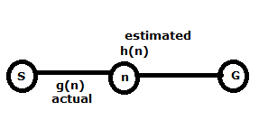
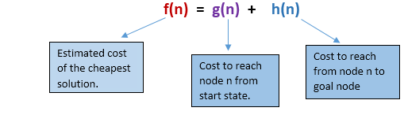
A* Search
A* search is the most commonly known form of best-first search. It uses heuristic function h(n), and g(n) i.e. cost to reach the node n from the start state
It has combined features of UCS and greedy best-first search, by which it solve the problem efficiently.
A* search algorithm finds the shortest path through the search space using the heuristic function.
The nodes of the graph can be evaluated by using two functions i.e. g(n) and h(n).
Here,
g(n) = Actual Cost/Distance to reach node “n” from start state
h(n) = Estimated Cost/Distance to reach from node “n” to the goal node.
For evaluating any node, function f(n) is generated and used as:

Slide 14
A* Search
In the first step, two list are maintained: OPEN list and CLOSED list.
Each node also maintains link pointer to its parent node. So that the best solution can be retrieved, if found.

Slide 15
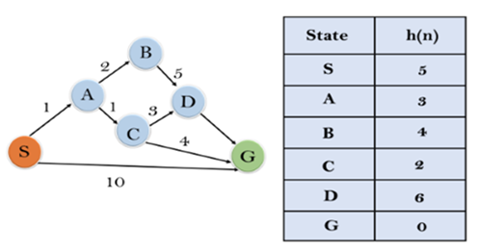
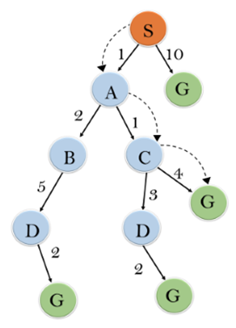
A* Search
f(n) = g(n) + h(n)
f(n) = 0 + 5
Initialization: {(S, 5)}
Iteration1: {(S→ A, 4), (S→G, 10)}
f(n) = 1+3=4 f(n)=10+0=10
Iteration2: {(S→ A→C, 4), (S→ A→B, 7), (S→G, 10)}
f(n)=1+1+2=4 f(n)=1+2+4=7
Iteration3: {(S→ A→C→G, 6), (S→ A→C→D, 11), (S→ A→B, 7), (S→G, 10)}
f(n)=1+1+4+0=6 f(n)=1+1+3+6=11
Iteration 4 will give the final result, as
S→ A→C→G
it provides the optimal path with cost 6.
Check:
(S→ A→B, 7) (S→ A→B→D, 1+2+5+6=14)
(S→ A→B→D→G, 1+2+5+2+0=10)
Solution:

Slide 16
A* Search
This search algorithm expands less search tree and provides optimal result faster.
Optimally efficient: The efficiency of A* algorithm depends on the quality of heuristic.
Complete: A* algorithm expands all nodes which satisfy the condition f(n)
Number nodes searched still exponential in the worst case so O(b^{d}) time & space complexity

Slide 17
Problem reduction
Problem reduction search is a technique used to reduce the problem complexity in artificial intelligence.
Problem reduction methods are strategic approach used to minimize the complexity of problems.
One popular approach is divide and conquer. Where the complex problem is divided into smaller and simpler problems.
We can apply reduction methods to form smaller sub goals. When all sub goals are achieved the final Complex goal is achieved. Sub goals are achieved by individual solutions and all solutions are combined to achieve the final solution.
LISP language provide support for such recursive break down. One can easily program search recursive programs in LISP for AI problems.

Slide 18
Problem reduction
Algorithm:
Step1: If problem is primitive sub problem get the solution.
Step2: If the problem is not a primitive sub problem, decompose it into smaller primitive sub-problems and call the algorithm recursively to solve the sub problems.
Step3: When we reach a state where all the problems are solved combine the solution.
We can represent a problem reduction using a special kind of graphs that is AND/OR graphs.
Whenever problem is decomposed AND architecture is generated. Whenever there is a need of representing an alternative action to be taken OR graph is used. The entire structure is called AND/OR graph.

Slide 19
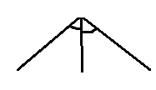

Problem reduction
AND node:
AND represents a scenario where all sub-problems must be solved to resolve the main problem.
The arc is drawn to represent AND node across branches.
One AND arc may point to a number of successor nodes, all of which must be solved in order for the arc to point to a solution.
OR node:
This represent scenario where solution to any sub problem will lead us to a solution of main problem.
OR node are used to represent a state space search graph.
OR graph, several arcs may emerge from a single node, indicating the variety of ways in which the original problem might be solved.

Slide 20
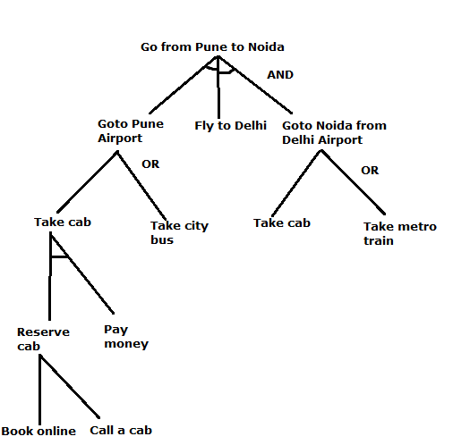
Problem reduction

Slide 21
AO* Search
AO* Algorithm basically based on problem decomposition (Breakdown problem into small pieces) and the AND-OR graphs or AND - OR trees are used for representing the solution.
Rather than two list, OPEN and CLOSED, that were used in A* algorithm, the AO* algorithm uses a single structure GRAPH i.e. “G “represents the part of the graph that has been generated so far.
Each node of the structure “G” is always connected either to its immediate successor or predecessor.
The nodes of the structure “G” also contains their respective distance/cost from each other. Each node store h-value, which is an estimate of the cost of path from itself to set of solution nodes.
The cost between the starting node to current node “n” i.e. g(n) will not stored
The algorithm always moves towards a lower cost value.
Basically, We will calculate the cost function here f(n)= g(n) + h(n)

Slide 22
AO* algorithm
Initialize the graph to start node
Traverse the graph following the current path accumulating nodes that have not yet been expanded or solved
Pick any of these nodes and expand it and if it has no successors call this value FUTILITY otherwise calculate only f(n) for each of the successors
If f(n) is 0 then mark the node as SOLVED
Change the value of f(n) for newly created node to reflect its successors by back-propagation
Whenever possible use the most promising routes and if a node is marked as SOLVED then mark the parent node as SOLVED
If starting node is SOLVED or value greater than FUTILITY, stop, else repeat from step 2

Slide 23
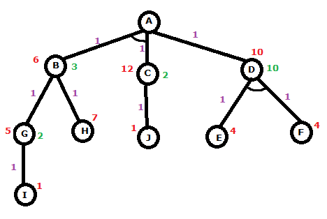
AO* Search
f(A-D)= 1+10 = 11 f(A-BC) = 1 + 1 + 6 +12 = 20
f(A-D-FE) = 1+1+ 4 +4 =10
And Heuristic value of node D also denote the cost of reaching FE from D. So, the new Heuristic value of D is 10. And the Cost from A-D remain same that is 11.
Check:
F(A-D)= 1+10 = 11 and F(A-BC) = 1 + 1 + 6 +12 = 20
F(B-G)= 5+1 =6 and F(B-H)= 7 + 1 = 8
F(G-I) = 1 +1 = 2 which is less than Heuristic value 5. So, the new Heuristic value form G to I is 2.
If it is a new value, then the cost from G to B must also have changed.
F(B-G)= 1+2 =3 . Mean the New Heuristic value of B is 3.
Cost form C to J F(C-J) = 1+1= 2 Which is less than Heuristic value
New Cost from A- BC that is F(A-BC) = 1+1+2+3 = 7 which is less than F(A-D)=11
Choosing path A-BC is more cost effective and good than that of A-D.

Slide 24
AO* Search
The solution is guaranteed in both algorithm.
A* always gives an optimal solution (shortest path with low cost). But It is not guaranteed to that AO* always provide an optimal solutions.
A* is used to find single solution whereas AO* is used to find more than one solution by ANDing more than one branch.

Slide 25
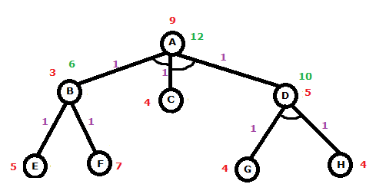
AO* Search
Solve this using AO* algorithm.
f(A-B-C) AND f(A-C-D)
PATH 1:
f(A-B-C) = 1+1+3+4 = 9
f(B-E) = 1+5 = 6 f(B-F) = 1+7 =8
f(A-B-C) = 1+ 1+6+4 = 12
PATH 2:
f(A-C-D) = 1+1+4+5 = 11
f(D-G-H) = 1+1+4+4 = 10
f(A-C-D) = 1+1+4+10 =16

Slide 26
Generate-and-Test
If the generation of possible solution is done systematically then this procedure will find a solution eventually, if one exist. Unfortunately if the problem space is very large, “eventually” maybe a very long time.
It is a depth first search procedure since complete solutions must be generated before they can be tested.
The most straightforward way to implement systematic generate and test is a depth first search tree with backtracking.
Generate and test can also operate by generating solution randomly but then there is no guarantee that a solution will ever be found.

Slide 27
Generate-and-Test
Algorithm:
Generate a possible solutions. For some problems this means generating a particular point in the problem space. For others it means generating a path from start State
Test to see if this is actually a solution by comparing the chosen point or the endpoint of the chosen path to set of acceptable goal states
If a solution has been found, quit otherwise, return to step 1
Properties of good generator
Complete solutions
Non redundant
informed

Slide 28




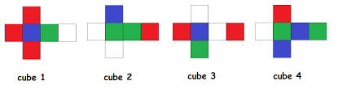
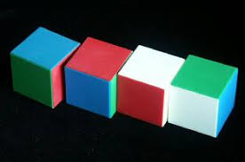
Examples: Generate-and-Test
0-99 = (100)³ = 1 MILLION possible solution
1 min = 5 possible solution
1 hrs = 5 X 60 = 300 solution
10 weeks
Heuristic – all numbers are prime
0-99 = (25)³ = 15000 approx.
Less than 2 days

Slide 29
Local search
Some problems where an aim is to find the goal constitutes a solution to the problem. But depending on the applications the path may or may not matter.
Examples:
n-puzzle, 8 queen, map colouring, crypt arithmetic
Integrated circuit design, telecommunication network optimisation etc.
If the path does not matter or a systematic search is not possible then consider another class of algorithms.
In such cases we use iterative improvement algorithms called local search.
Idea:
keep a single "current" state, and try to improve it
It move only to the neighbours of that state, based on the cost function

Slide 30
Local search
Advantages:
No need to maintain a search tree.
Use very little memory.
Faster compared to other algorithms
Disadvantage:
Often fails to give optimal solution.
Hill climbing is one of the local search algorithm.

Slide 31
Hill climbing: Local search
Hill climbing algorithm is a local search algorithm which continuously moves in the direction of increasing elevation/value to find the peak of the mountain or best solution to the problem. It terminates when it reaches a peak value where no neighbour has a higher value.
Hill climbing algorithm is a technique which is used for optimizing the mathematical problems. One of the widely discussed examples of Hill climbing algorithm is Travelling-salesman Problem in which we need to minimize the distance travelled by the salesman.
It is also called greedy local search as it only looks to its good immediate neighbour state and not beyond that.
A node of hill climbing algorithm has two components which are state and value.
Hill Climbing is mostly used when a good heuristic is available.
In this algorithm, we don't need to maintain and handle the search tree or graph as it only keeps a single current state.

Slide 32
Hill climbing: Local search
Following are some main features of Hill Climbing Algorithm:
Generate and Test variant: Hill Climbing is the variant of Generate and Test method. The Generate and Test method produce feedback which helps to decide which direction to move in the search space.
Greedy approach: Hill-climbing algorithm search moves in the direction which optimizes the cost.
No backtracking: It does not backtrack the search space, as it does not remember the previous states

Slide 33
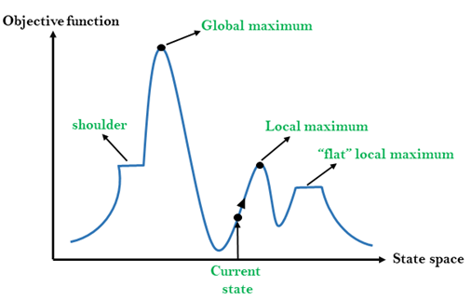
Hill climbing representation
On Y-axis we have taken the function which can be an objective function or cost function, and state-space on the x-axis.
Local Maximum: state which is better than its neighbour states
Global Maximum: best possible state of state space
Flat local maximum: flat space, all neighbour states of current, have the same value
Shoulder: It is a plateau region which has an uphill edge.

Slide 34
Types: Simple hill climbing
It only evaluates the neighbour node state at a time and selects the first one which optimizes current cost and set it as a current state.
Algorithm:
Step 1: Evaluate the initial state, if it is goal state then return success and Stop.
Step 2: Loop Until a solution is found or there is no new operator left to apply.
Step 3: Select and apply an operator to the current state.
Step 4: Check new state:
If it is goal state, then return success and quit.
Else if it is better than the current state then assign new state as a current state.
Else if not better than the current state, then return to step2.
Step 5: Exit.
This algorithm is less time consuming and less optimal solution and the solution is not guaranteed

Slide 35
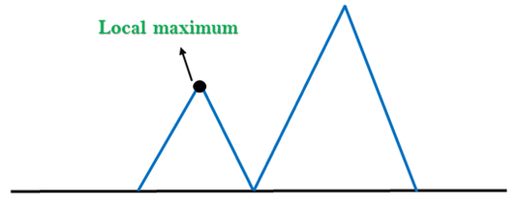
Problems in hill climbing
1. Local Maximum: A local maximum is a peak state in the landscape which is better than each of its neighbouring states, but there is another state also present which is higher than the local maximum.
Solution: Backtracking; algorithm can backtrack the search space and explore other paths as well.

Slide 36
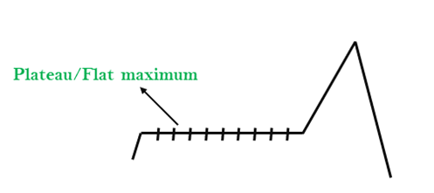
Problems in hill climbing
2. Plateau/Flat maximum: A plateau is the flat area of the search space in which all the neighbour states of the current state contains the same value, because of this algorithm does not find any best direction to move and might be lost in the plateau area.
Solution: Take big steps or very little steps while searching; Randomly select a state which is far away from the current state.

Slide 37
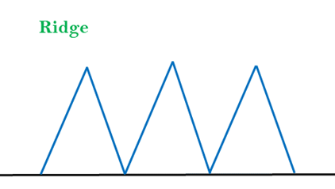
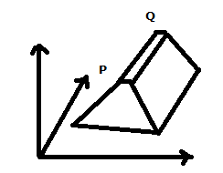
Problems in hill climbing
3. Ridges: A ridge is a special form of the local maximum. It has an area which is higher than its surrounding areas, but itself has a slope, and cannot be reached in a single move.
Solution: Use of bidirectional search; by moving in different directions, we can improve this problem.

Slide 38
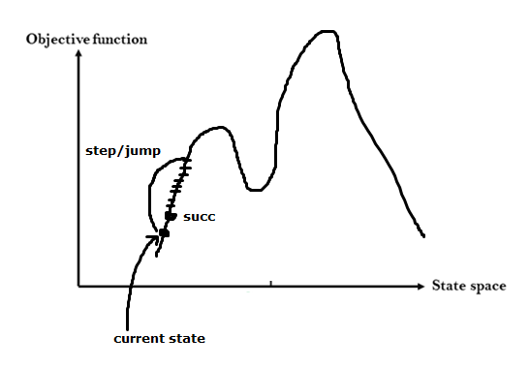
Types: Steepest-Ascent hill climbing
The steepest-Ascent algorithm is a variation of simple hill climbing algorithm.
This algorithm examines all the neighbouring nodes of the current state and selects one neighbour node which is closest to the goal state.
This algorithm consumes more time as it searches for multiple neighbours

Slide 39
Types: Steepest-Ascent hill climbing
Step 1: Evaluate the initial state, if it is goal state then return success and stop, else make current state as initial state.
Step 2: Loop until a solution is found or the current state does not change.
Let SUCC be a state such that any successor of the current state will be better than it.
For each operator that applies to the current state:
Apply the new operator and generate a new state.
Evaluate the new state.
If it is goal state, then return it and quit, else compare it to the SUCC.
If it is better than SUCC, then set new state as SUCC.
If the SUCC is better than the current state, then set current state to SUCC.
Step 3: Exit.

Slide 40
Types of Hill climbing
Stochastic hill climbing:
Stochastic hill climbing does not examine for all its neighbour before moving.
Rather, this search algorithm selects one neighbour node at random and decides whether to choose it as a current state or examine another state.

Slide 41
Simulated Annealing
A hill-climbing algorithm which never makes a move towards a lower value guaranteed to be incomplete because it can get stuck on a local maximum.
And if algorithm applies a random walk, by moving a successor, then it may complete but not efficient. Simulated Annealing is an algorithm which yields both efficiency and completeness.
In mechanical term Annealing is a process of hardening a metal or glass .
The same process is used in simulated annealing in which the algorithm picks a random move, instead of picking the best move.
If the random move improves the state, then it follows the same path.
Otherwise, the algorithm follows the path which has a probability of less than 1 or it moves downhill and chooses another path.

Slide 42
Constraint Satisfaction Problem
Many problems in AI can be viewed as a problems of constraint satisfaction in which the goal is to discover some problem state that satisfies a given set of constraints.
Satisfiability
Scheduling
Time tabling
Supply chain management
Graph coloring
Machine vision
Puzzles

Slide 43
Constraint Satisfaction Problem
A CSP consist of:
A finite set of variables which stores the solution (X= {x1, x2, x3,....., xn})
For each variable xi in X, domain Di
A domain Di, finite set of possible values, from which the solution is picked (D = {D1, D2, D3,.....,Dn}) one for each variable
A finite set of constraints (C = {C1, C2, C3,......, Cn}) that specify allowable combination of values. Restricting tuples of values
If only pairs of values, it’s a binary CSP
A solution is an assignment of value in Di to each variable xi such that every constraint satisfied

Slide 44
Constraint satisfaction problem
Ci = (Scope, Rel)
Where,
Scope is set of variables that participate in the constraint
Rel is relation that define the values
Example: x1 and x2 variables having domain D1 and D2 respectively. And having constraint is x1 is not equal to x2.
C1 = ((x1,x2), (x1 ≠ x2)) OR C1 = ((x1,x2), (D1,D2))
D1 =(1,2) and D2 = (2,4)
C1 = ((x1,x2), (1,2), (1,4), (2,4))

Slide 45
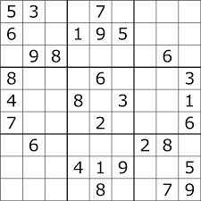
Constraint satisfaction problem
A solution is an assignment of value in Di to each variable xi such that every constraint satisfied
Sudoku puzzle:
Variables X = remaining squares that are to be filled (total=81 will reduce)
Domain D= range of no that can fill them i.e. (1-9)
Constraints C = conditions governing how variable will choose
its domain (row, column, block != repeated no)

Slide 46
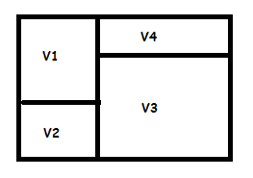
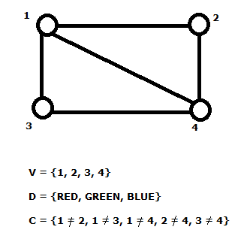
Constraint Satisfaction
Can we colour all four regions with three colours so that no two adjacent regions are the same colours?
Constraints for each edge
Xi ≠ Xj ........binary CSP

Slide 47

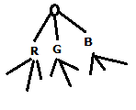
Constraint Satisfaction
 | 1 | 2 | 3 | 4
Initial Domain | R,G,B | R,G,B | R,G,B | R,G,B
1 = R | R | G,B | G,B | G,B
2 = G | R | G | G,B | B
3 = B | R | G | B | empty
Problem :
Empty value
3 = G | R | G | G | B
Backtracking
State space

Slide 48
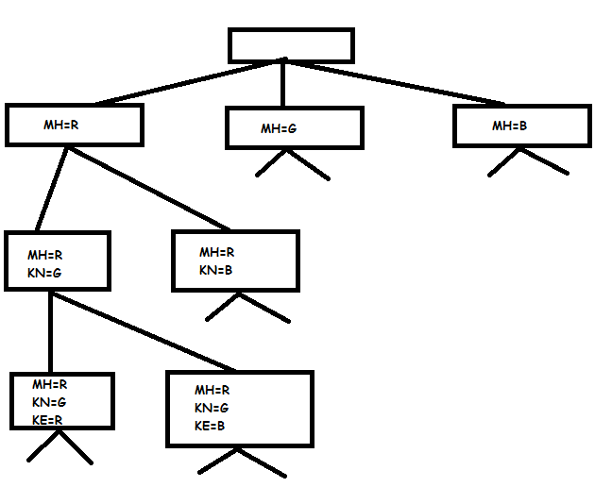
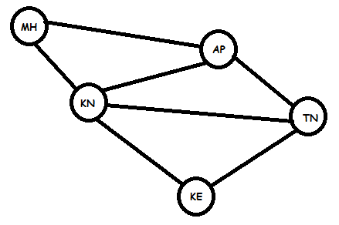
Example 2: CSP
State space tree

Slide 49
Example 2: CSP
 | MH | KN | KE | AP | TN
Initial domain | RGB | RGB | RGB | RGB | RGB
MH=R | R | GB | RGB | GB | RGB
KN=G | R | G | RB | B | RB
KE=R | R | G | R | B | B
AP=B | R | G | R | B | empty
KE=B | R | G | B | B | R

Slide 50
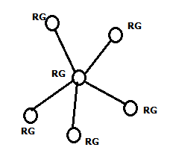
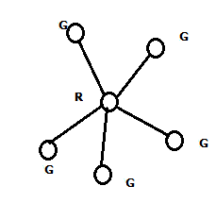
Constraint Satisfaction
Without heuristic: with two colors
2 to power 6 = 32 possibilities
With heuristics:
Only 5 possibilities
Time efficient

Slide 51
Formulation: CSP
Initial state: initial state is defined by empty assignment. None of the variable is assigned its value.
Successor function: the value can be assigned to a variable with one restriction that it should not conflict with any previous assignment.
Goal test: whenever the current assignment is complete, it is checked that all assignment has been performed or not.
Path cost: for each assignment step, one cost is attached. Total cost is sum of all assignment cost

Slide 52
Crypt-arithmetic problem
Crypt arithmetic Problem is a type of constraint satisfaction problem where the game is about digits and its unique replacement either with alphabets or other symbols.
The digits (0-9) get substituted by some possible alphabets or symbols to get the result arithmetically correct.
The rules or constraints on a crypt arithmetic problem are as follows:
Unique digit to be replaced with a unique alphabet.
Result should satisfy the predefined arithmetic rules
Digits should be from 0-9 only
There should be only one carry forward, while performing the addition operation
The problem can be solved from both sides L.H.S and R.H.S

Slide 53
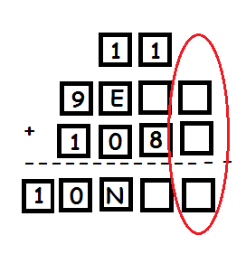
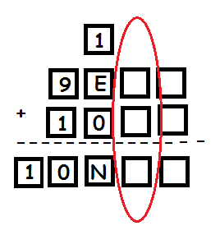
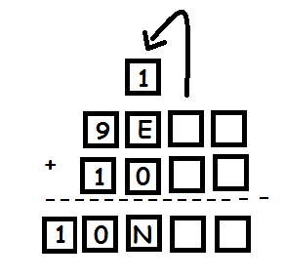
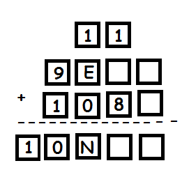
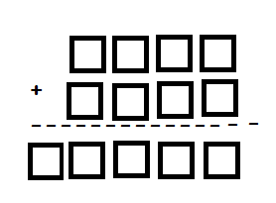
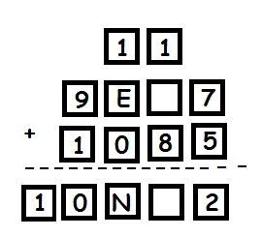
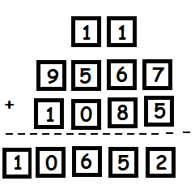
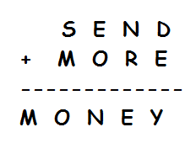
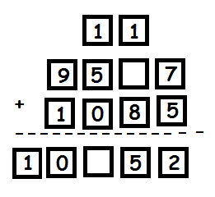
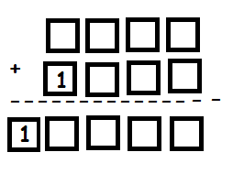
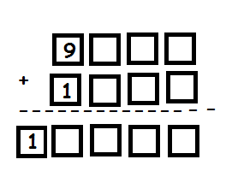
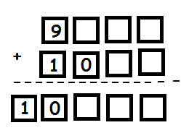
Crypt-arithmetic problem
Character | Code
S | 9
E
N
D
M | 1
O | 0
R | 8
Y
Character | Code
S
E
N
D
M | 1
O
R
Y
Character | Code
S | 9
E
N
D
M | 1
O | 0
R
Y
Character | Code
S | 9
E | 5
N
D | 7
M | 1
O | 0
R | 8
Y | 2
Character | Code
S | 9
E
N
D
M | 1
O
R
Y
Character | Code
S | 9
E | 5
N | 6
D | 7
M | 1
O | 0
R | 8
Y | 2
Now, D + E = Y, has to be such that it generates a carry.
D + E has to add up to more than 11 as Y can't be 0 or 1
Possibilities are 7 + 6 or 7 + 5 and so on
So now we can conclude E + 1 = N (N and E differ by 1)
Solve expression: Substituting expression 1 in 2, we get
E + 1 + R(+1) = E + 10
Hence, R(+1) =9
If we don’t consider carry, then R has to be 9, which is not possible, so considering the carry. Hence it now R = 8
Hence, N = 6
Only when S = 9, it can generate a carry. Also now we know the value for ‘O’ as well.
E + 0 = E should be, but we find that it is N (not E).
Hence this proves that there is carry in this step only then this is possible.
For this carry to get generated, the sum of the previous values should be more than 10.
So we get, N + R = 10 + E
But there might be a carry as well(we still didn’t know about)
Hence we write, N + R (+1) = E + 10 ......(+1 will consider only if needed)
So now, O = 0
As S + M will generate a carry, which can be only one

Slide 54
Mean End Analysis
The MEA technique was first introduced in 1961 by Allen Newell, and Herbert A. Simon in their problem-solving computer program, which was named as General Problem Solver (GPS). GPS encapsulated the heuristic approach which they called Mean End Analysis.
The MEA analysis process centered on the evaluation of the difference between the current state and goal state.
It is a mixture of Backward and forward search technique
it possible that first to solve the major part of a problem and then go back and solve the small problems arise during combining the big parts of the problem
MEA problem solving technique is used in AI for limiting search in AI programs.

Slide 55
Mean End Analysis
Compare the current state with desired state, and
List the difference between them
Evaluate the difference between in terms of magnitude (in some way)
Consult an operator difference table
Reduce largest (most important) difference first
The difference characterizes the ends that need to be achieved
The operators defines the means of achieving those ends

Slide 56
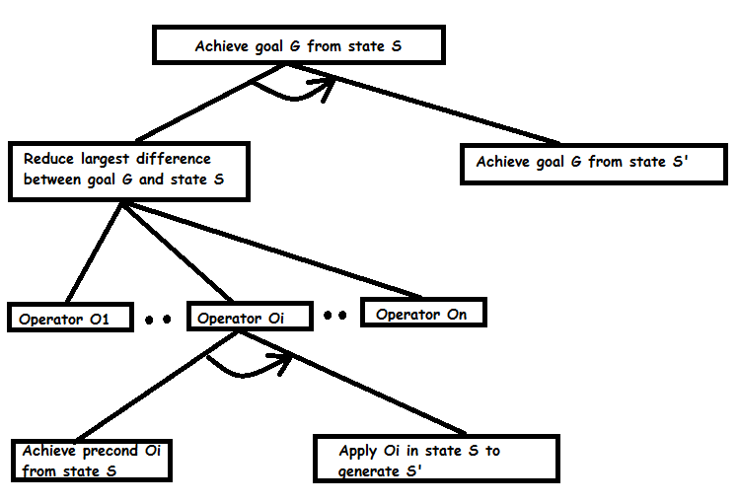
Mean End Analysis
The MEA strategy generates an AND/OR tree by replicating this structure below the shaded nodes when a recursive call is made.

Slide 57
Mean End Analysis
Working of MEA technique :
First, evaluate the difference between Initial State and final State.
Select the various operators which can be applied for each difference.
Apply the operator at each difference, which reduces the difference between the current state and goal state.
Operator Sub-goaling: Sometimes it is possible that an operator cannot be applied to the current state. Sub goals are set up to establish the preconditions of the operator is called Operator Subgoaling.

Slide 58
Mean End Analysis
Algorithm:
Let's we take Current state as CURRENT and Goal State as GOAL, then following are the steps for the MEA algorithm.
Step 1: Compare CURRENT to GOAL, if there are no differences between both then return Success and Exit.
Step 2: Else, select the most significant difference and reduce it by doing the following steps until the success or failure occurs.
Select a new operator O which is applicable for the current difference, and if there is no such operator, then signal failure.
Attempt to apply operator O to CURRENT. Make a description of two states. i)O-Start, a state in which O’s preconditions are satisfied. ii) O-Result, the state that would result if O were applied In O-start.
If (First-Part<------MEA(CURRENT,O-START) And (LAST-Part <----- MEA (O-Result, GOAL), are successful, then signal Success and return the result of combining FIRST-PART, O, and LAST-PART.

Slide 59
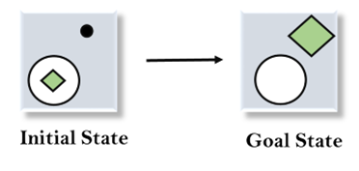
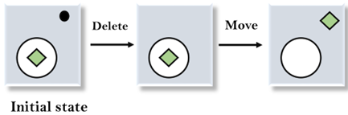

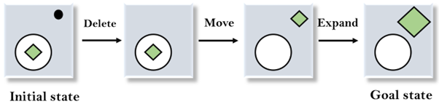
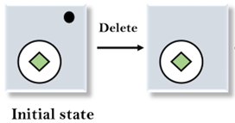
Mean End Analysis
Operators: Move, Delete and Expand
Applying expand operator
Evaluate initial step
Applying move operator
Applying delete operator

Slide 60
Stochastic search
Stochastic search algorithms strongly use randomized decisions while searching for the solution to a given problem.
the method of choice for solving many hard combinatorial problems.
Over the past few years there has been considerable success in developing stochastic local search algorithms as well as randomized systematic search methods for solving these problems and to date for many problem domains the best known algorithms are based on so stochastic search techniques.
Stochastic search is where certain steps are based on random choice.
Most stochastic search algorithms were shown effective and efficient in finding near-optimal solutions to complex problems, but with no guarantee of finding true global optima

